Slide 1
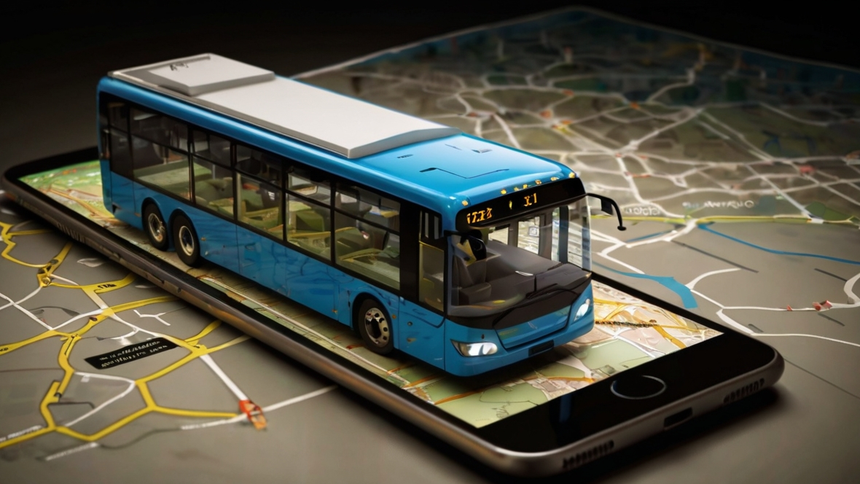

e-Conductor
Group 09
(Next Level of Sri Lankan Public Transport)
Department of Computer Engineering
Faculty of Engineering
University of Peradeniya
Sri Lanka

Slide 2






OUR TEAM
SUPERVISOR
Prof. Manjula Sandirigama
E/20/032
Bandara A.M.N.C.
E/20/035
Bandara K.C.H.N.A.W.M.R.C.J.N.
E/20/133 Haththella H.A.D.T.N.
E/20/157
Janakantha S.M.B.G.

Slide 3
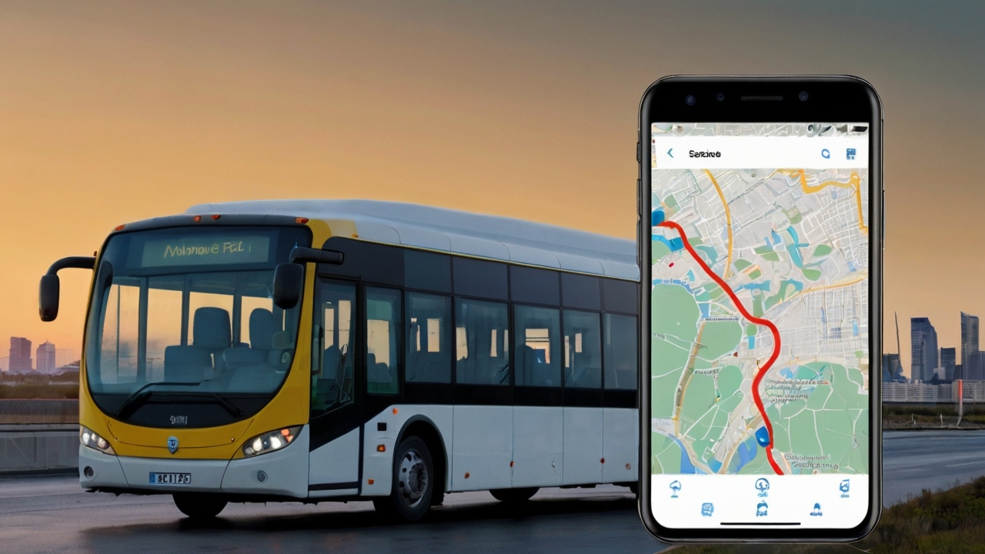
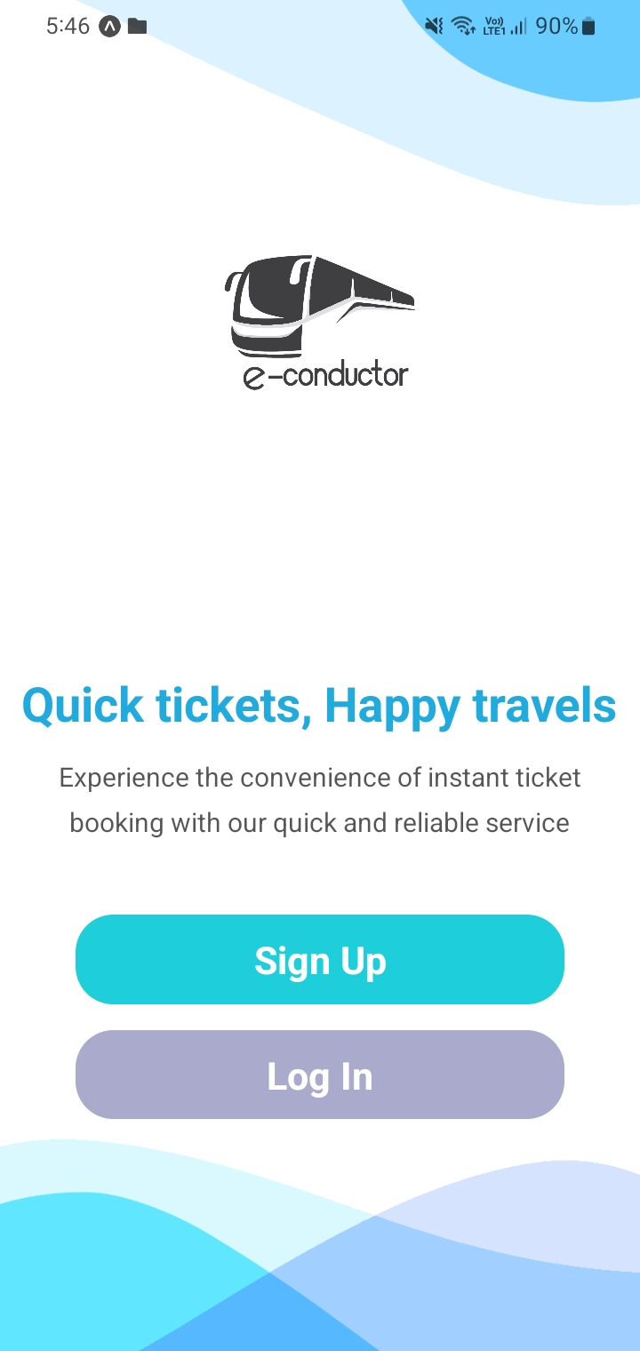





INTRODUCTION
Provide a convenient online platform
Streamline booking process, enhance user experience.
Search routes, select seats, live location tracking
Convenience, ease of use compared to traditional methods.
Improving accessibility to bus travel

Slide 4





CORE FUNCTIONALITIES
Web App
Mobile App
Admin Site
Login / Signup
Ticket Booking
Ticket Cancelling
Reload Account
Realtime Bus Tracking
Earnings Analysis
Schedule Management
Login / Signup
Profile
Ticket Booking
Ticket Cancelling
Transactions
Realtime Bus Tracking
Analytics
Login / Signup
Transaction Tracking
User Tracking
Schedule Management
Bus & Bus Stop Tracking

Slide 5
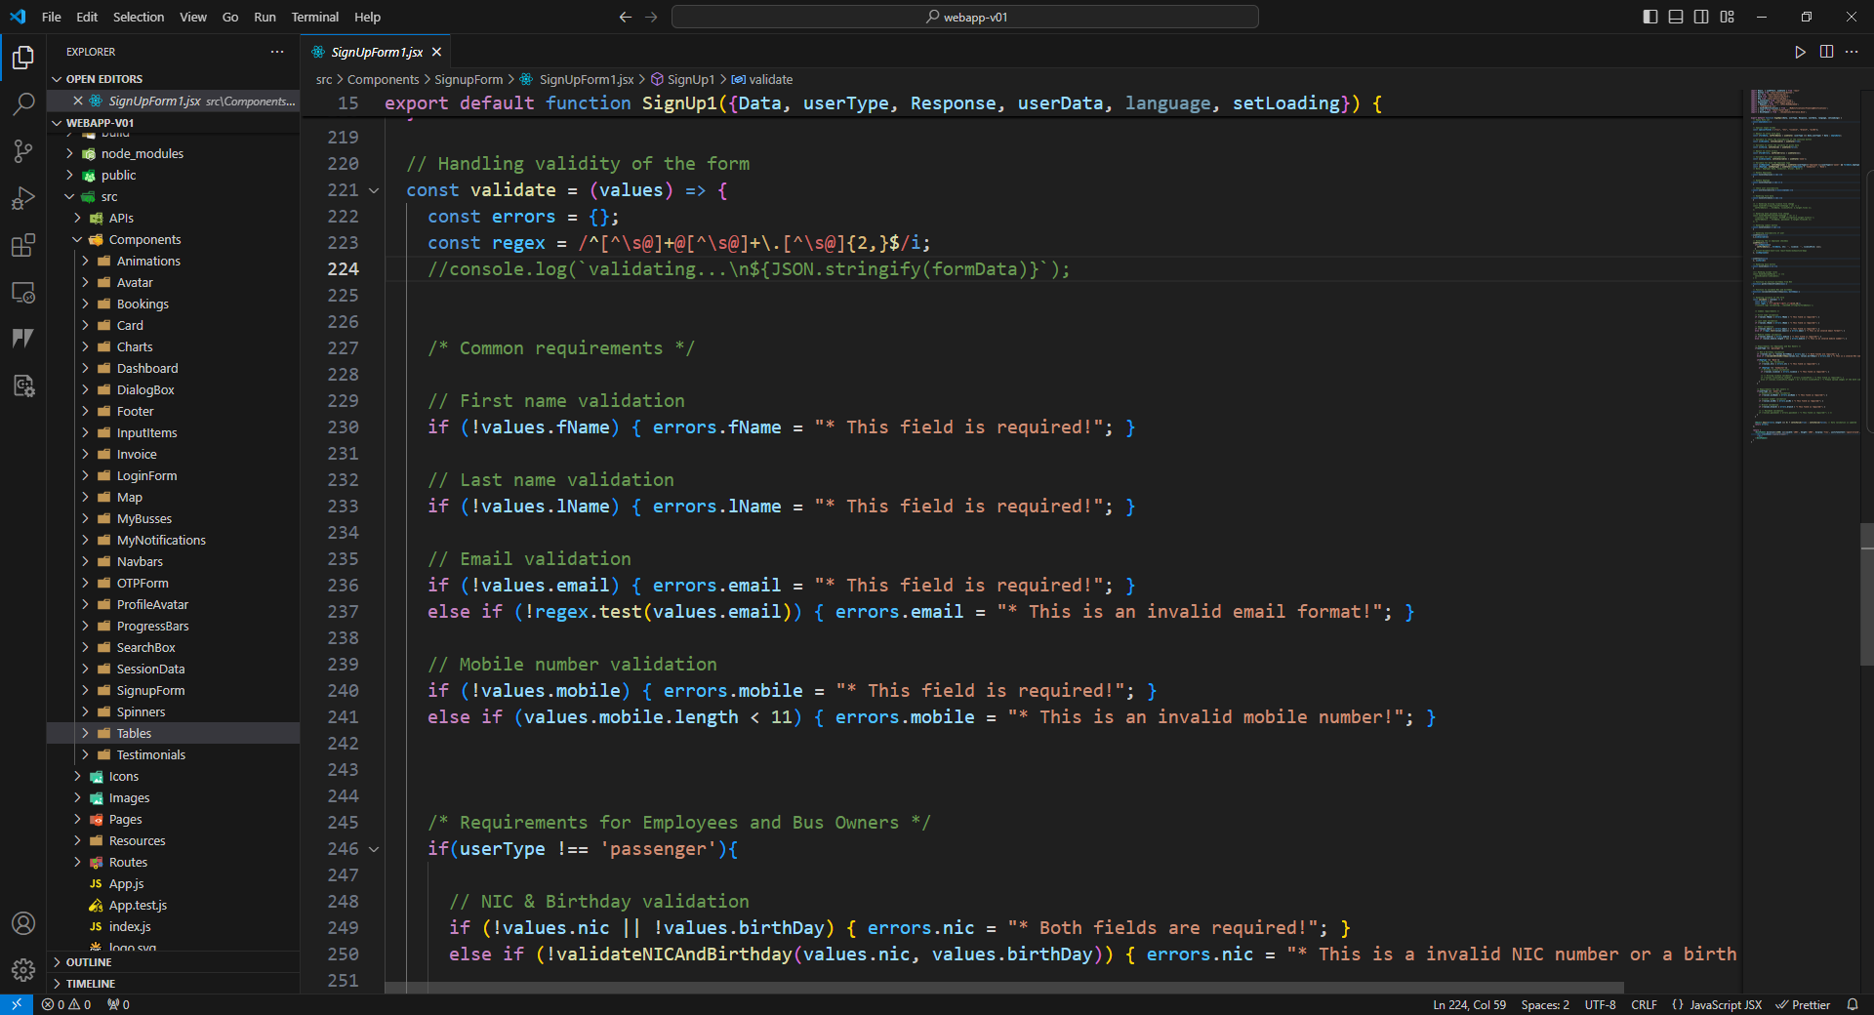
CODE & VALIDATIONS

Slide 6
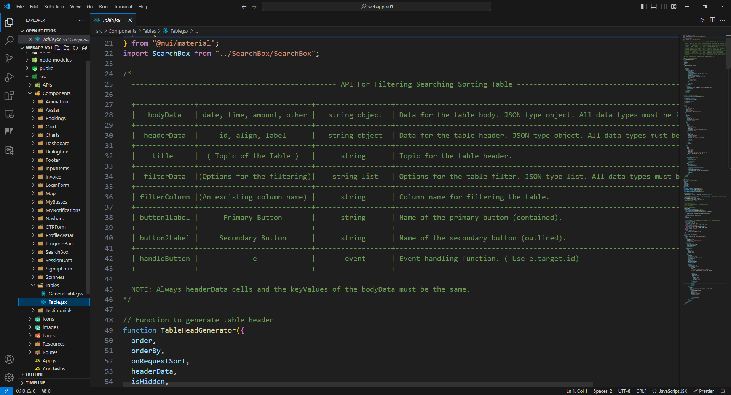
CODE & DOCUMENTAION

Slide 7
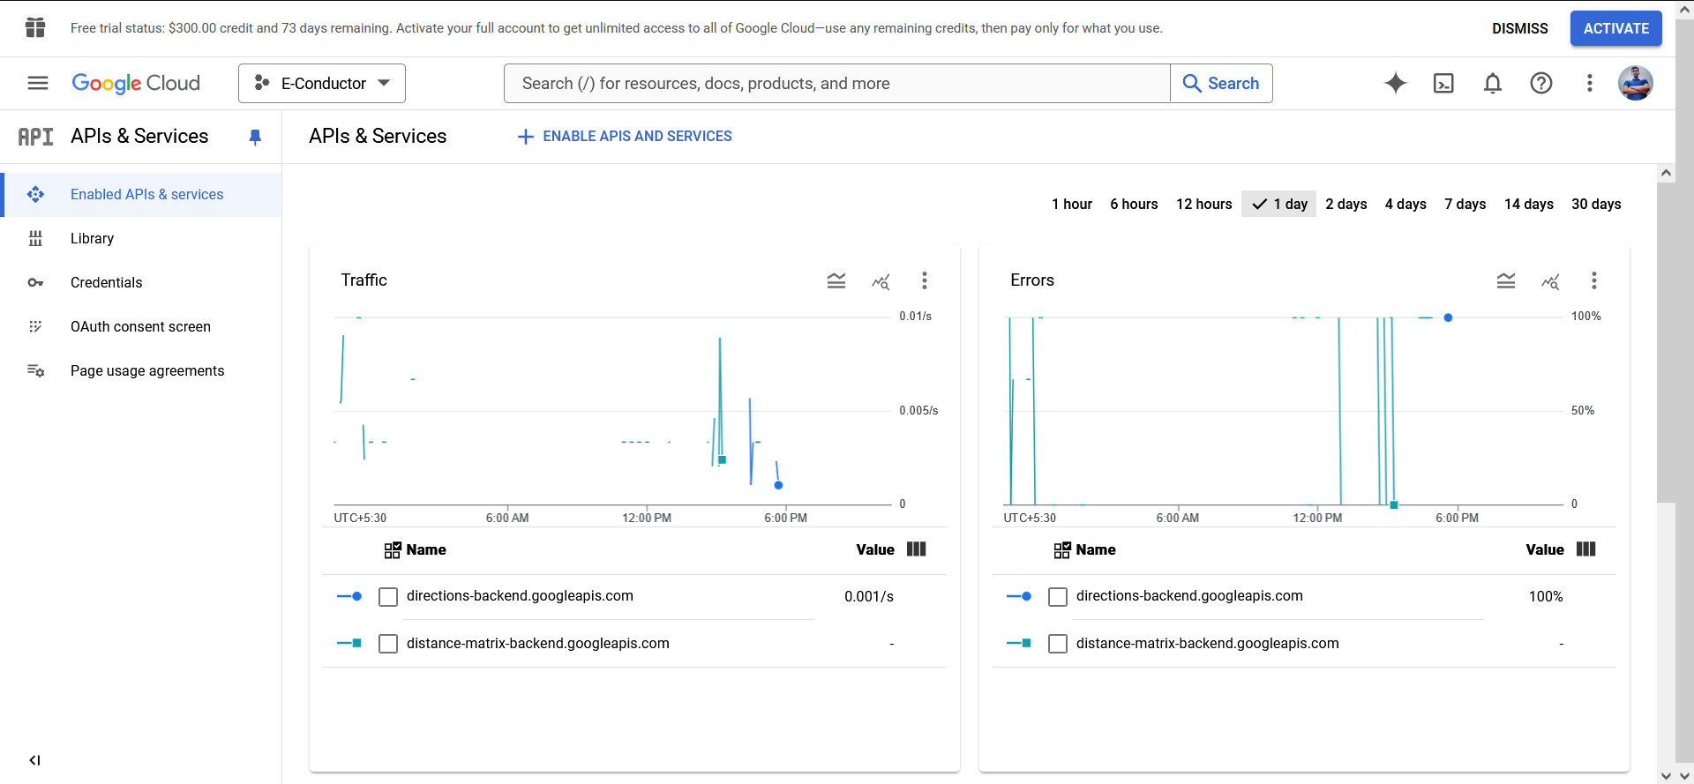


TESTING & BUG FIXING

Slide 8
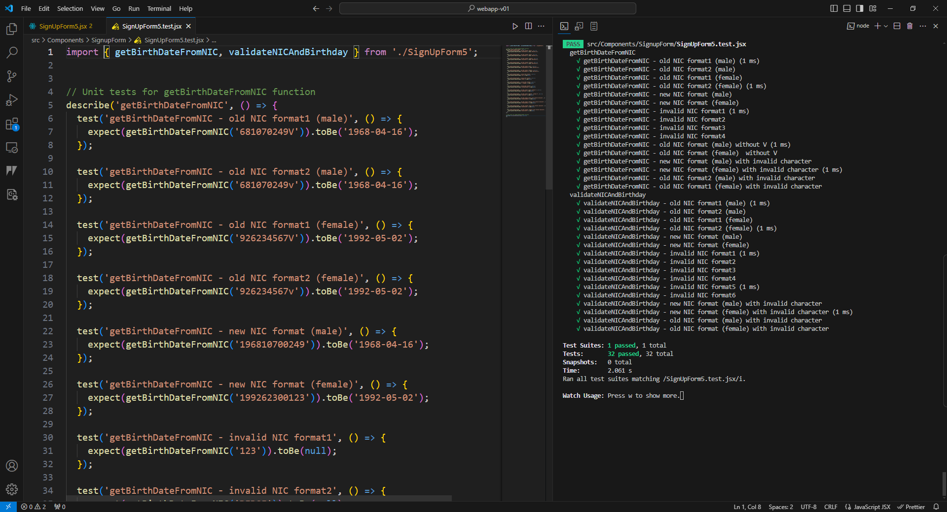



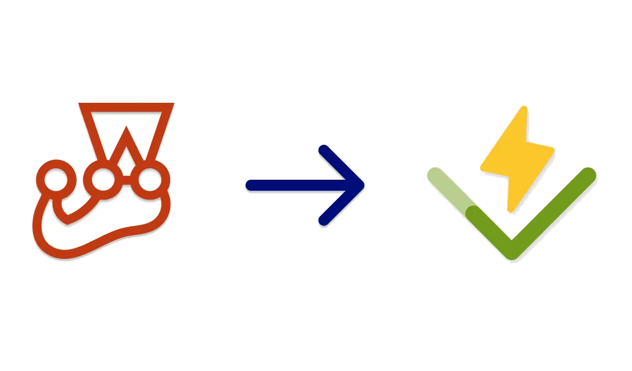

TESTING & BUG FIXING

Slide 9
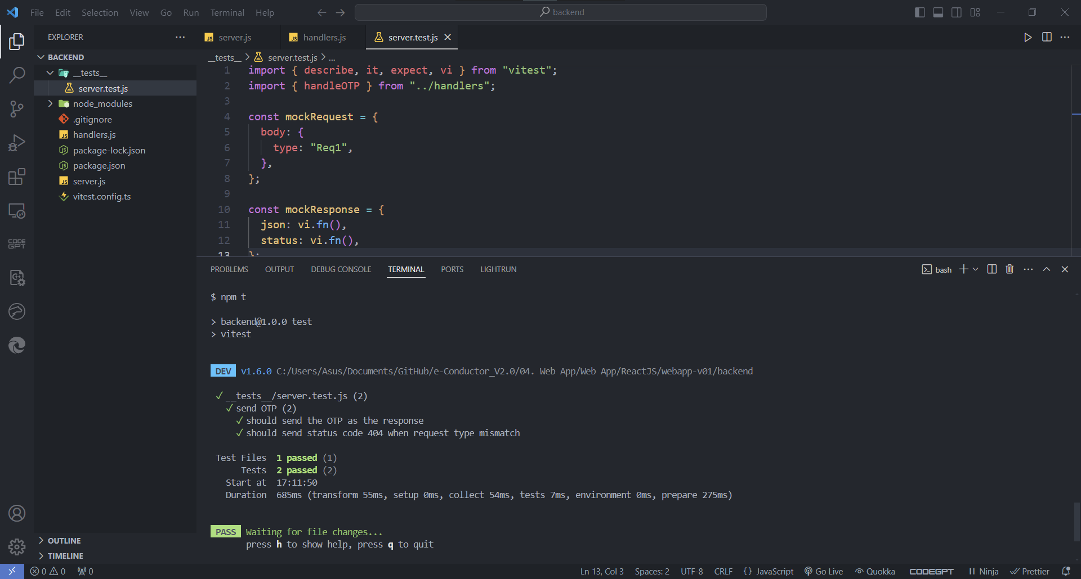
TESTING & BUG FIXING

Slide 10





PROGRESS
OVERALL PROGRESS
Web
App
Mobile App
Database
Backend

Slide 11
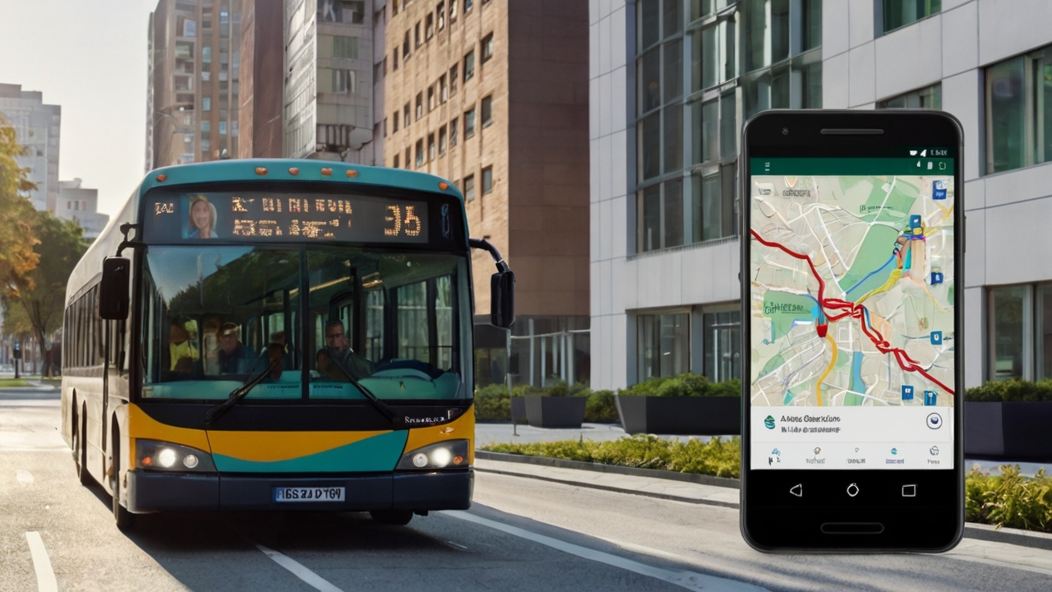







TIME LINE
THANK YOU
Web App
Mobile App
Database
Testing & Debugging
Payment Gateway
App Launching
Backend
Live Location Tracking

Slide 12







WEB APP - Passenger
LOGIN & AUTHENTICATION
TICKET BOOKING
TICKET CANCELLING
RELOAD ACCOUNT
BUS LOCATION TRACKING
https://e-conductor-v2-0.pages.dev

Slide 13
LOGIN & AUTHENTICATION
Notes:
User Friendly Login Signup system
For the time been we show only the login process
Here is the quick overview of the web site

Slide 14
TICKET BOOKING
Notes:
Here is the ticket booking process
Select from to & date
Select bus (filtering feature)
Select seats
payment

Slide 15
TICKET CANCELLING
Notes:
We can see available tickets here

Slide 16
RELOAD ACCOUNT
Notes:
Google Pay gateway

Slide 17
BUS LOCATION TRACKING

Slide 18


WEB APP – Bus Owner
VIEW EARNINGS
ANALYTICS
https://e-conductor-v2-0.pages.dev

Slide 19
LOGIN / AUTHENTICATION

Slide 20
VIEW EARNINGS
Notes:
All details about his own busses
Currently working on this

Slide 21
ANALYTICS
Notes:
Quick overview of the earnings of the owner
Current moth earnings
Current da

Slide 22
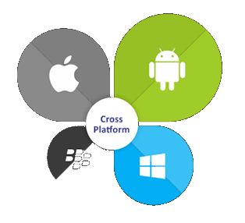



MOBILE APP
PASSENGER FEATURES
BUS OPERATOR FEATURES
BUS OWNER FEATURES

Slide 23
PASSENGER FEATURES

Slide 24
BUS OPERATOR FEATURES

Slide 25
BUS OWNER FEATURES

Slide 26




ADMIN SITE
ADMIN DASHBOARD
TRANSACTION TRACKING
USER TRACKING
BOOKING HANDLING
LOCATION TRACKING

Slide 27
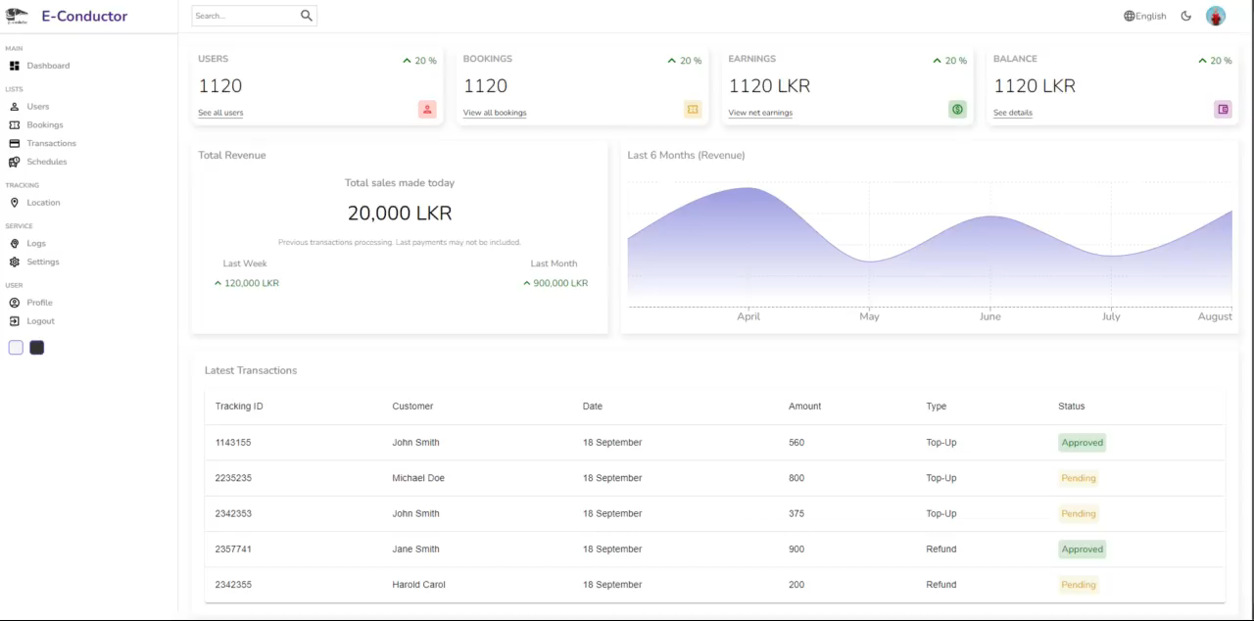
ADMIN DASHBOARD

Slide 28
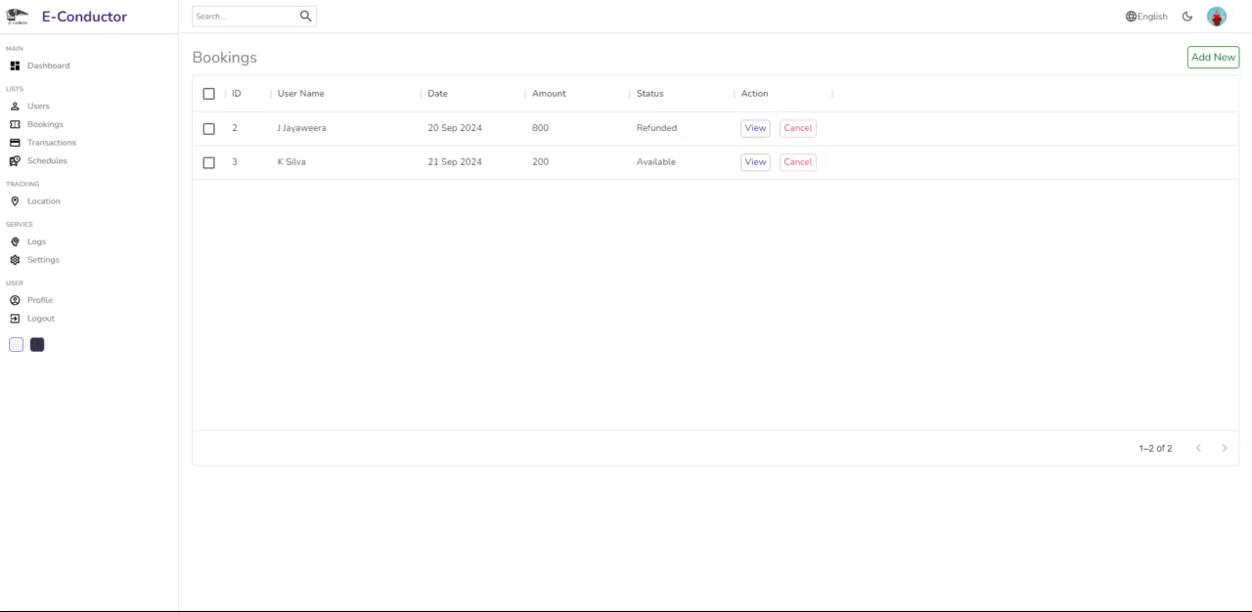
TRANSACTION TRACKING

Slide 29
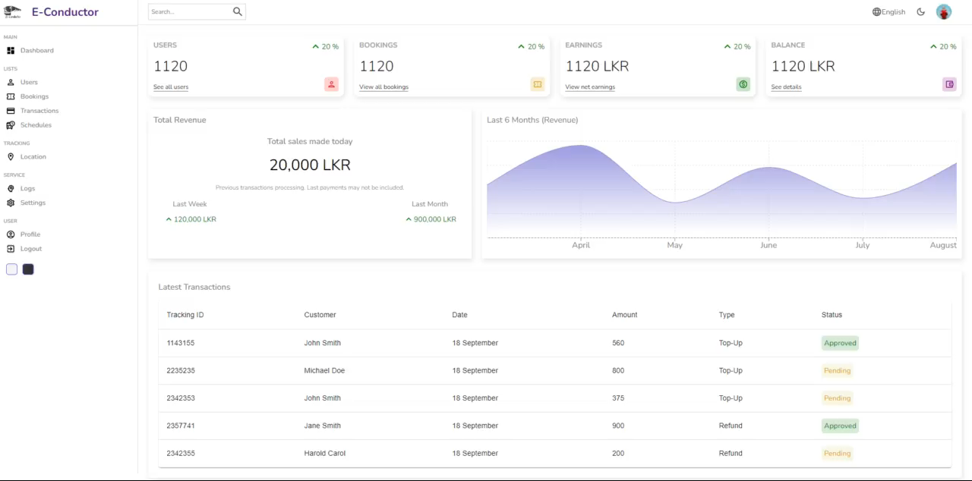
USER TRACKING

Slide 30
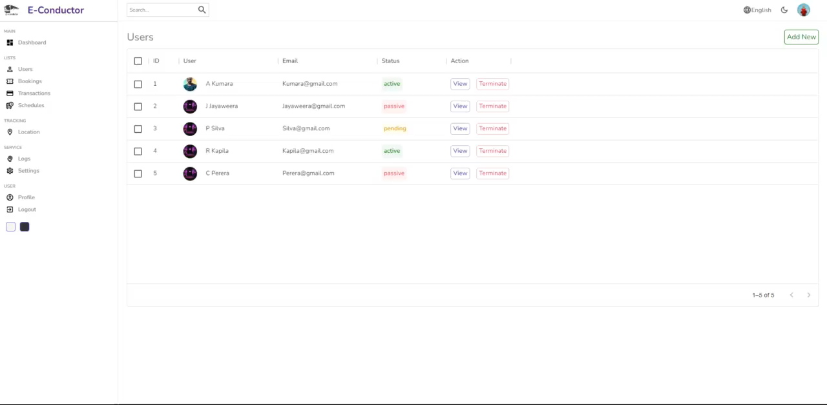
BOOKING HANDLING

Slide 31
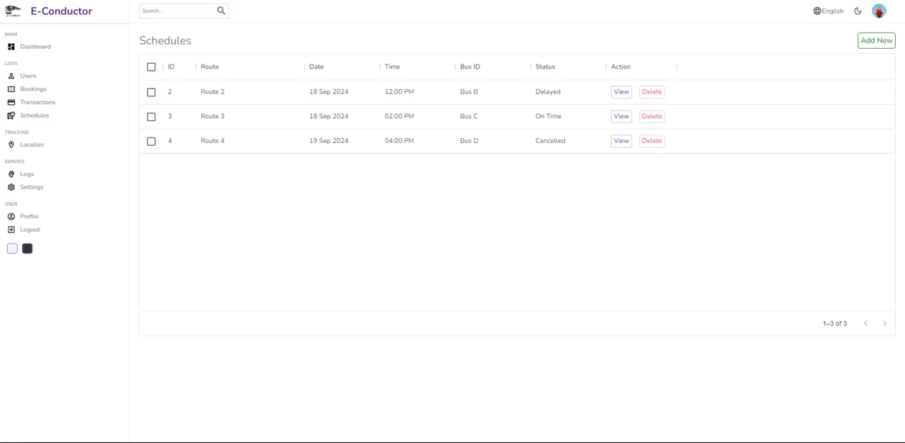
LOCATION TRACKING

Slide 32
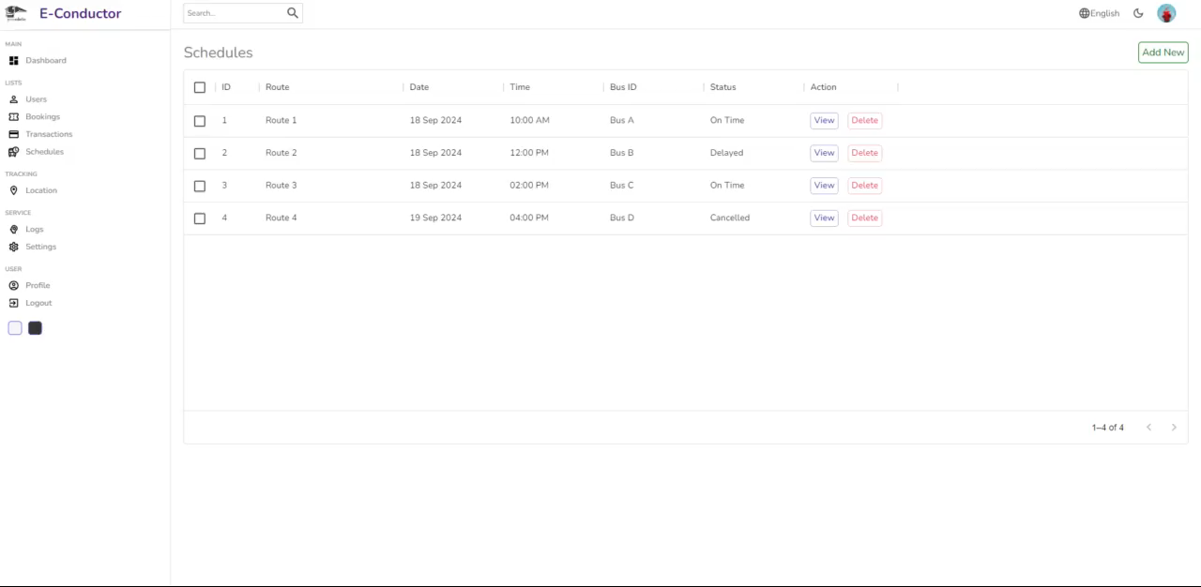
OTHER FEATURES

Slide 33

CONTRIBUTION
E/20/032
Bandara
A.M.N.C.
(Admin Site & Database)
E/20/035
Bandara K.C.H.N.A.W.M.R.C.J.N
(Client Site – Mobile App)
E/20/133
Haththella
H.A.D.T.N.
(Backend)
E/20/157
Janakantha S.M.B.G.
(Client Site – Web App)
Login / Signup ☑
Admin Dashboard ☑
Revenue Tracking ☑
User Tracking ☑
Transaction Tracking ☑
Booking Management ☑
Transaction Management ☑
Location Tracking ☑
Fee Calculation Editor □
Activity Log □
Settings Page □
Deployment □
Testing And Debugging □
Login / Signup ☑
User Dashboard ☑
Ticket Booking ☑
Ticket Cancelling ☑
Live Location Tracking ☑
Google Map ☑
Bus Owner Dashboard ☑
Bus Operator Dashboard ☑
Earning Analysis ☑
General Pages (Home…) ☑
Payment Gateway □
QR Scanner □
Testing And Debugging □
Authentication ☑
User Logs ☑
User Management ☑
Ticket Booking ☑
Ticket Cancelling ☑
Live Location Tracking ☑
Schedule Fetching ☑
Transaction Management ☑
Payment Gateway □
Bus owner dashboard □
Deployment ☑
Testing and debugging □
Login / Signup ☑
User Dashboard ☑
Ticket Booking ☑
Ticket Cancelling ☑
Live Location Tracking ☑
Google Map ☑
Payment Gateway ☑
Bus Owner Dashboard ☑
Earning Analysis ☑
General Pages (Home…) ☑
Adding Animations ☑
Deployment ☑
Testing And Debugging □

Slide 34

THANK YOU
Q&A
Web App
Mobile App
Database
Testing & Debugging
Payment Gateway
App Launching
Backend
Live Location Tracking

